Slide 1
BINARY SEARCH TREE

Slide 2
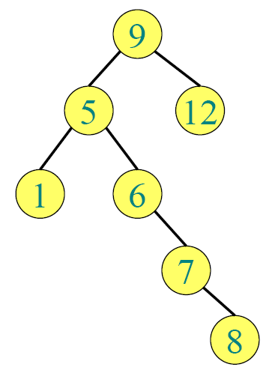
DEFINITION: A binary tree is called binary search tree(T) if each node N of T has the property: The value at N is greater than every value in the left sub tree of N and less than or equal to every value in the right sub tree of N.

Slide 3
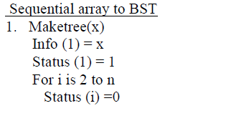
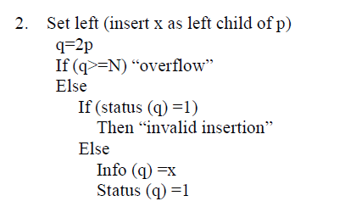

Slide 4
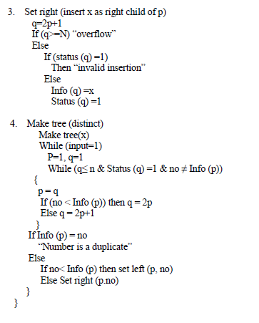

Slide 5
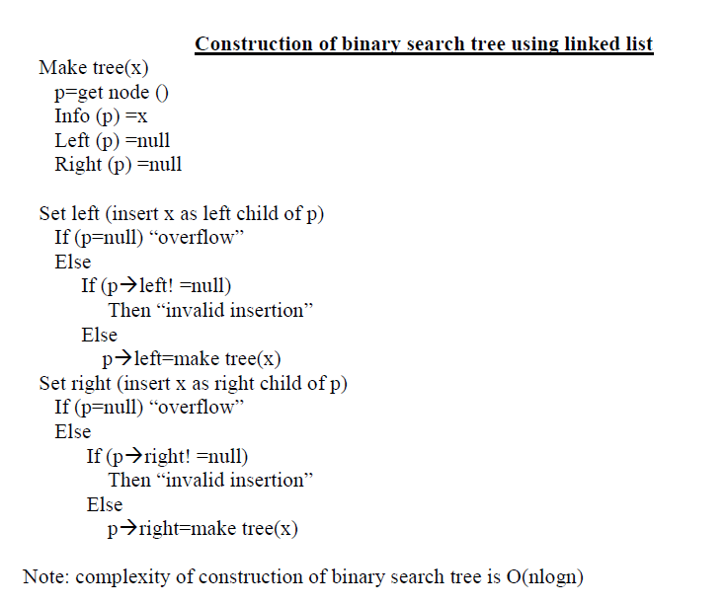
CONSTRUCTION OF BINARY SEARCH TREE (using linked list)

Slide 6
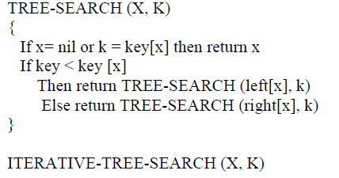
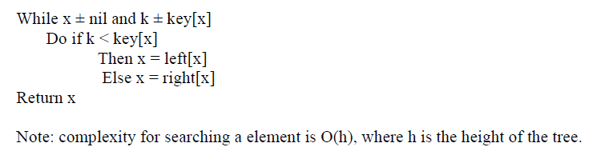

Slide 7
TRAVERSING BINARY SEARCH TREES
There are three standard ways of traversing a binary search tree T with root R. These three algorithms are called preorder, in order, post order.
Preorder (p)
If p! =null
Visit info (p)
Preorder (left (p))
Preorder (right (p))

Slide 8
In order (p)
If p! =null
In order (left (p))
Visit info (p)
In order (right (p))
Post order (p)
If p! =null
Post order (left (p))
Post order (right (p))
Visit info (p)
Note: complexity for traversing the binary search tree is O (n)

Slide 9
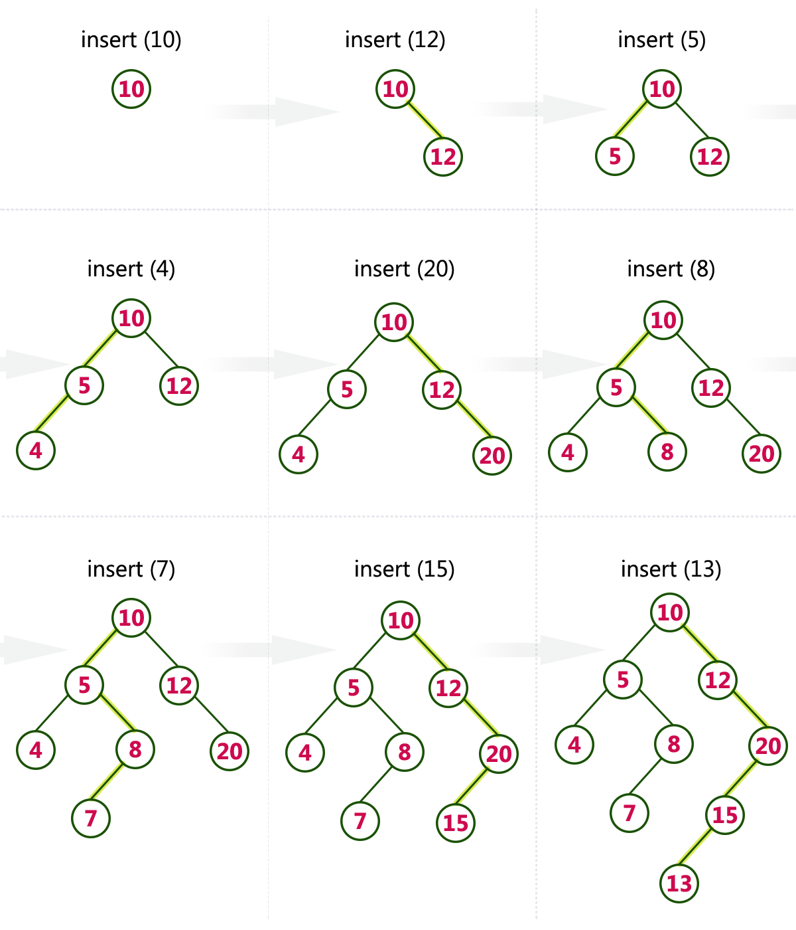
INSERTING AN ELEMENT

Slide 10
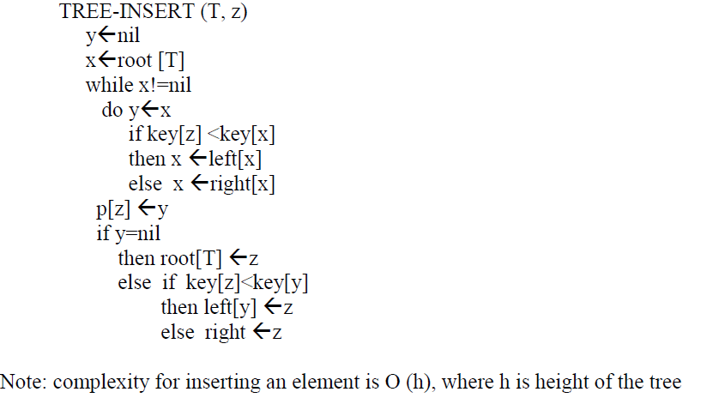

Slide 11
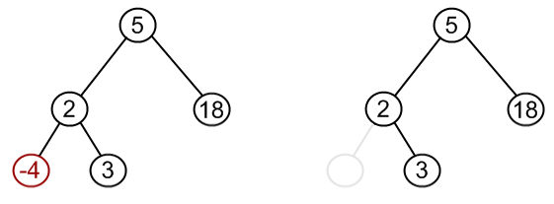
DELETION OF AN ELEMENT
The procedure for deleting a given node z from a binary search tree has 3 cases
1. If z has no children, we modify its parent p[z] to replace z with nul as its child.

Slide 12
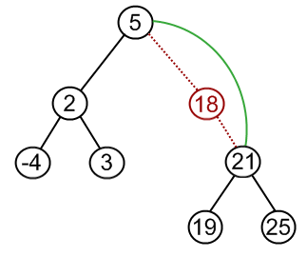
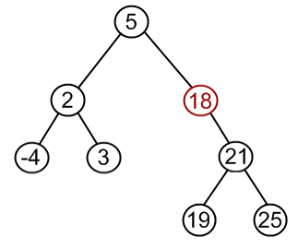
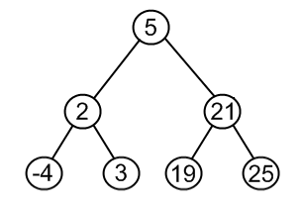
2. If the node has only a single child, we slice out by making a new link between its child and its parent.

Slide 13
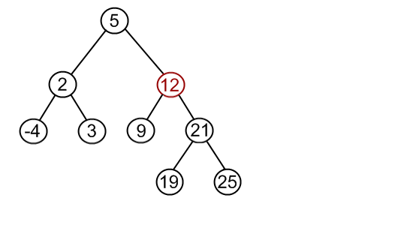
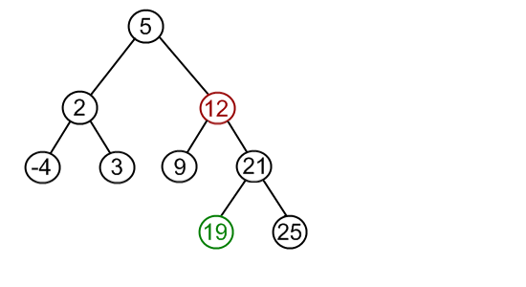
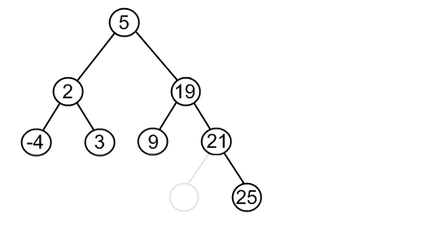
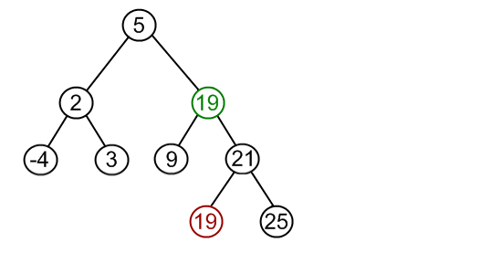
3. If the node has two children, we slice out z’s successor y, which has no left child and replace z’s

Slide 14
